Slide 1
Attention
Abdul Samad

Slide 2
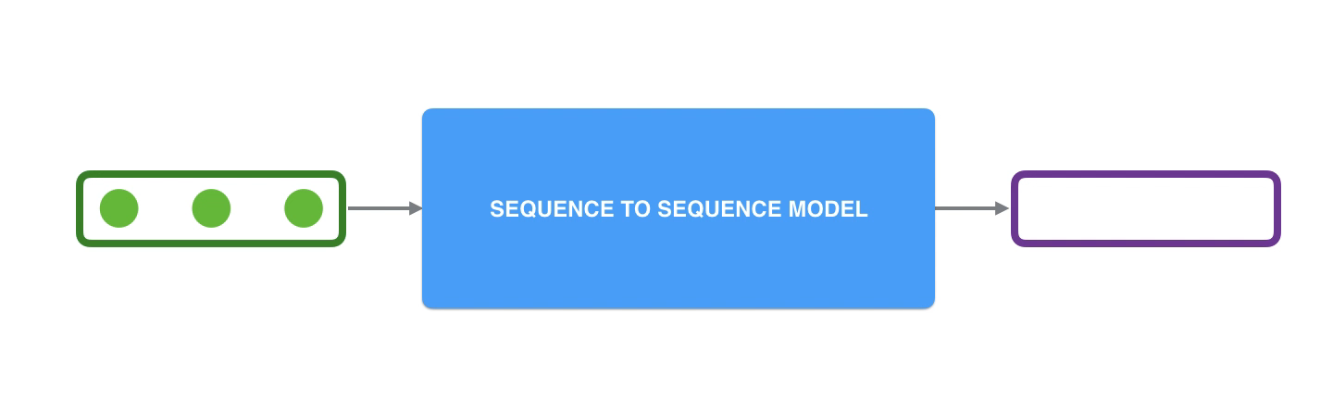
Sequence to Sequence Model
https://jalammar.github.io/
Notes:
A sequence-to-sequence model is a model that takes a sequence of items (words, letters, features of an images…etc) and outputs another sequence of items.

Slide 3
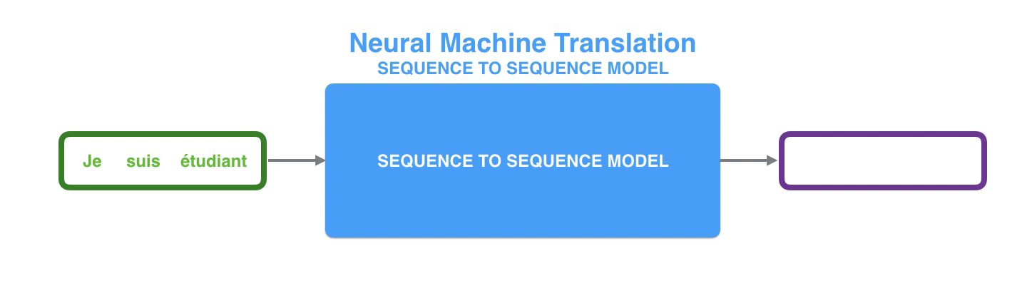
Neural Machine Translation

Slide 4
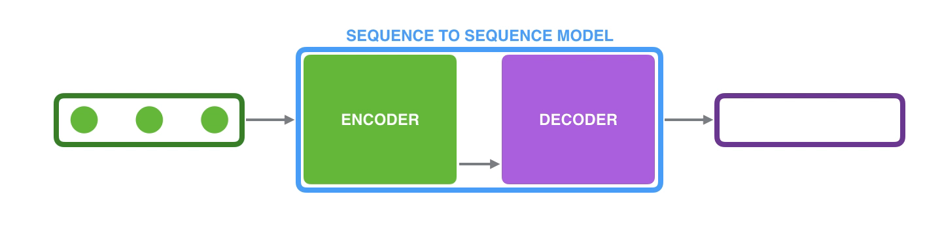
Looking Under The Hood
Notes:
Looking under the hood
Under the hood, the model is composed of an encoder and a decoder.
The encoder processes each item in the input sequence, it compiles the information it captures into a vector (called the context). After processing the entire input sequence, the encoder sends the context over to the decoder, which begins producing the output sequence item by item.

Slide 5
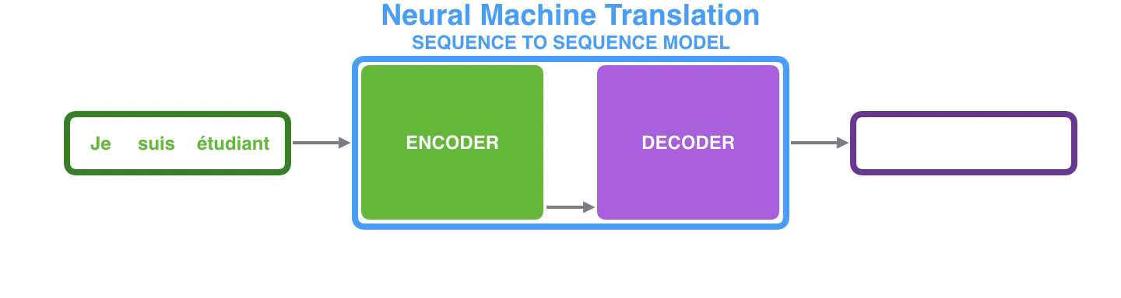
Machine Translation

Slide 6
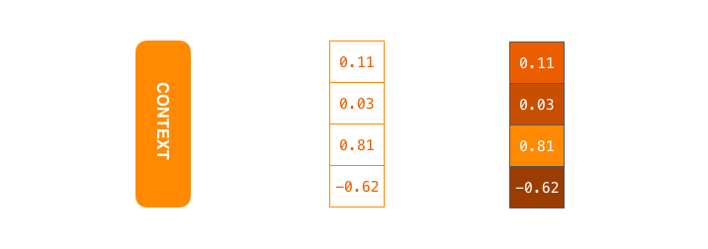
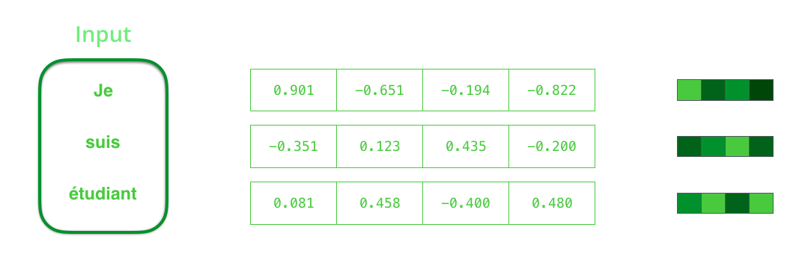
Context-Vector and Word-embedding

Slide 7
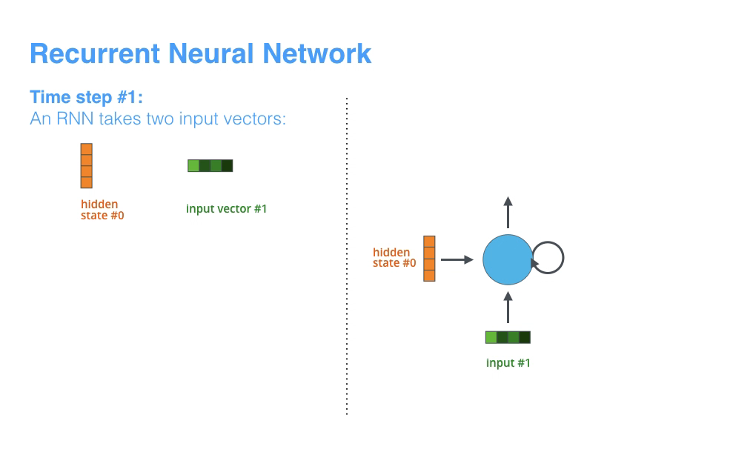
RNN- glance

Slide 8
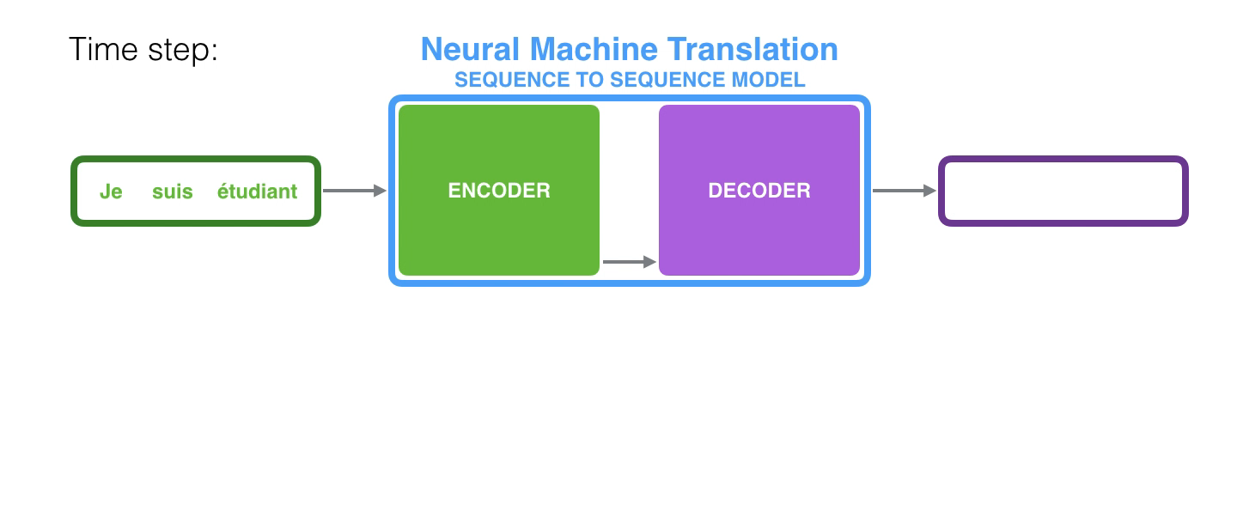
Neural machine Translation

Slide 9
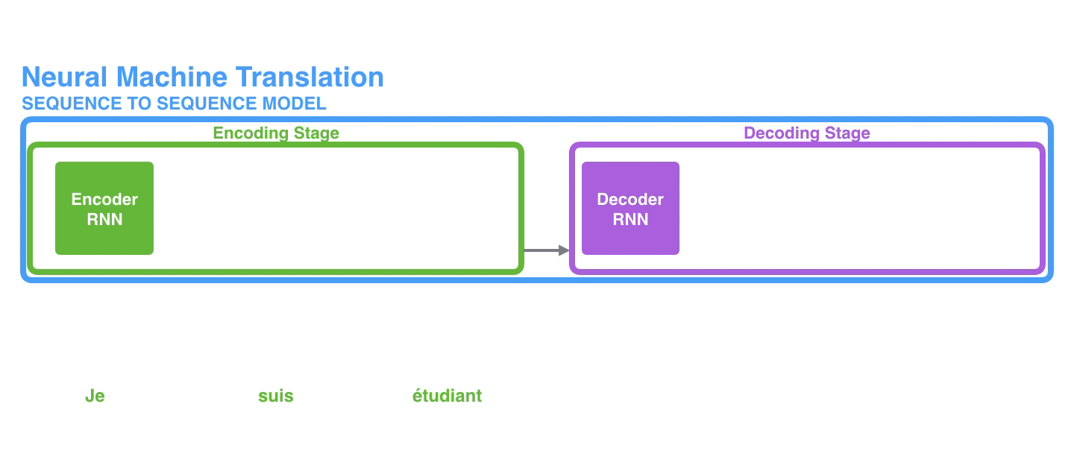
Neural machine Translation

Slide 10
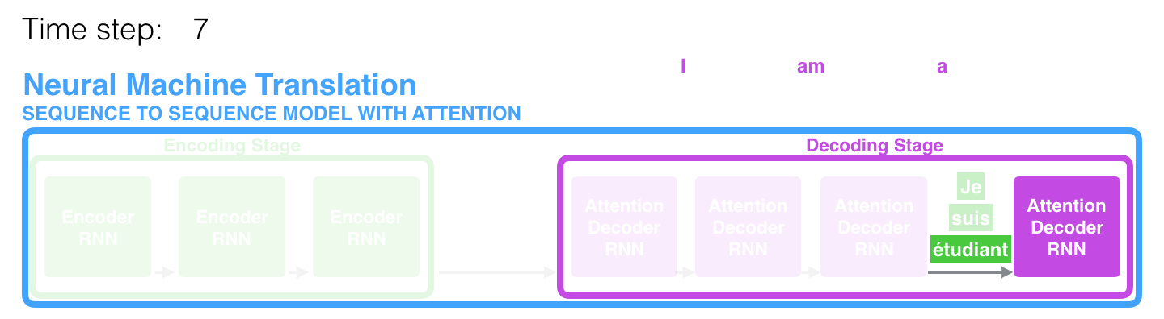
Bottleneck
Notes:
The context vector turned out to be a bottleneck for these types of models. It made it challenging for the models to deal with long sentences. A solution was proposed in Bahdanau et al., 2014 and Luong et al., 2015. These papers introduced and refined a technique called “Attention”, which highly improved the quality of machine translation systems. Attention allows the model to focus on the relevant parts of the input sequence as needed

Slide 11
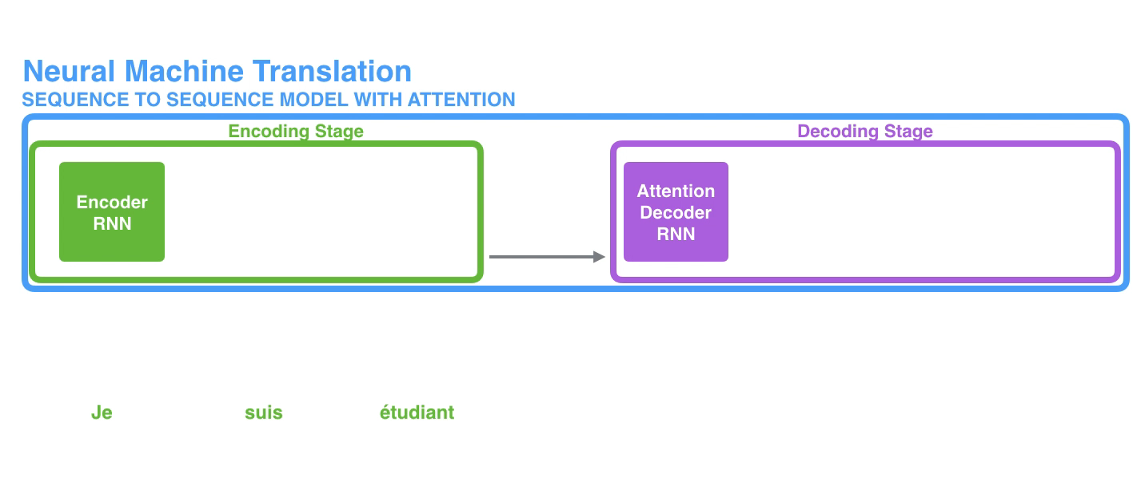
Attention
Notes:
First, the encoder passes a lot more data to the decoder. Instead of passing the last hidden state of the encoding stage, the encoder passes all the hidden states to the decoder:

Slide 12
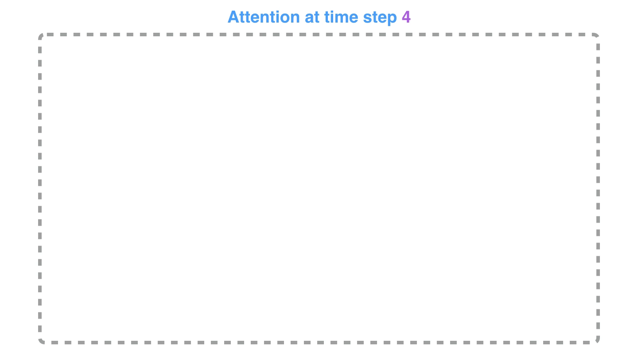
Attention Process
Notes:
Second, an attention decoder does an extra step before producing its output. In order to focus on the parts of the input that are relevant to this decoding time step, the decoder does the following:
Look at the set of encoder hidden states it received – each encoder hidden state is most associated with a certain word in the input sentence
Give each hidden state a score (let’s ignore how the scoring is done for now)
Multiply each hidden state by its softmaxed score, thus amplifying hidden states with high scores, and drowning out hidden states with low scores

Slide 13
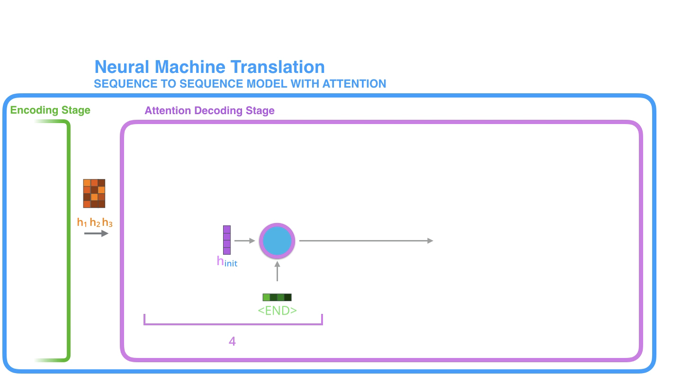
Attention Process

Slide 14
Illustrated Transformer https://jalammar.github.io/illustrated-transformer/

Slide 15




Transformer
Notes:
The encoding component is a stack of encoders (the paper stacks six of them on top of each other – there’s nothing magical about the number six, one can definitely experiment with other arrangements). The decoding component is a stack of decoders of the same number.

Slide 16
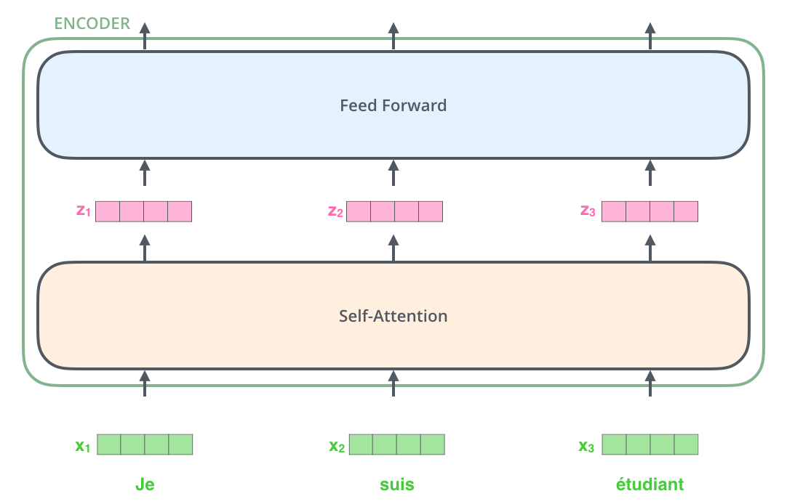
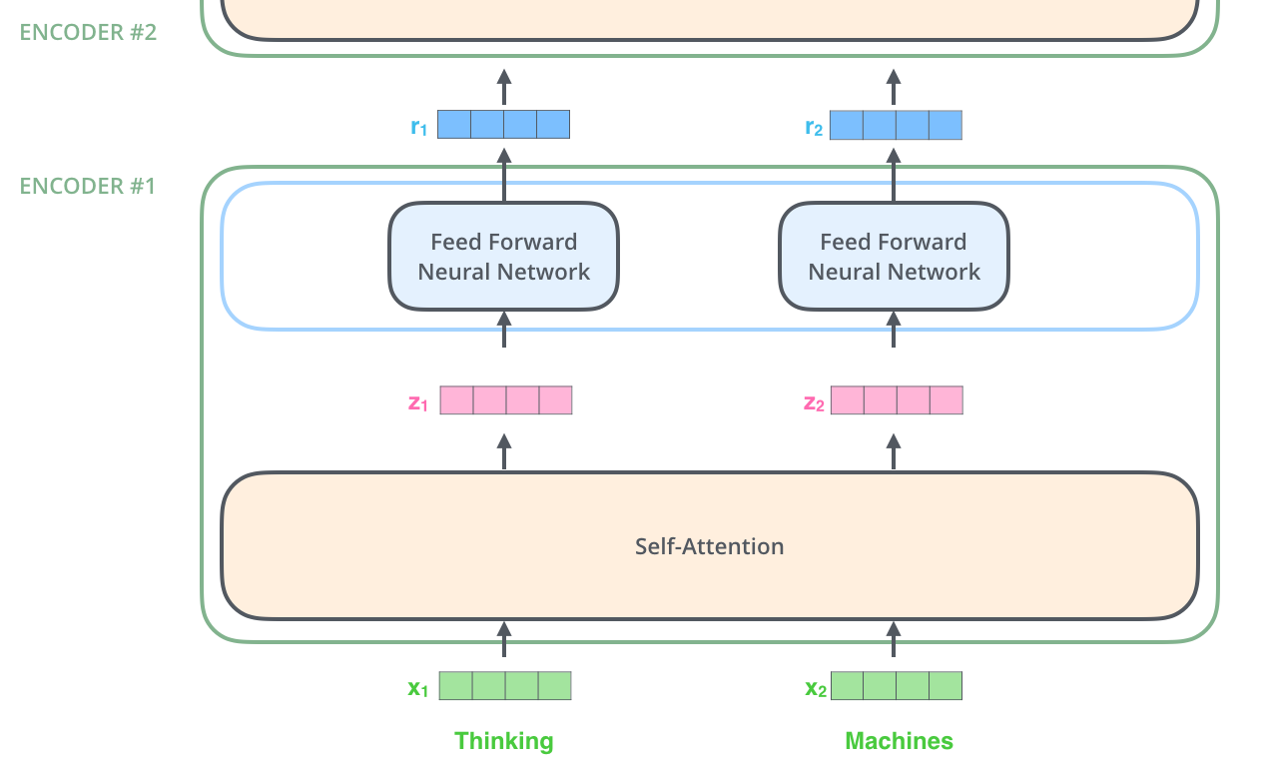
Encoder
Notes:
The embedding only happens in the bottom-most encoder. The abstraction that is common to all the encoders is that they receive a list of vectors each of the size 512 – In the bottom encoder that would be the word embeddings, but in other encoders, it would be the output of the encoder that’s directly below. The size of this list is hyperparameter we can set – basically it would be the length of the longest sentence in our training dataset.
Here we begin to see one key property of the Transformer, which is that the word in each position flows through its own path in the encoder. There are dependencies between these paths in the self-attention layer. The feed-forward layer does not have those dependencies, however, and thus the various paths can be executed in parallel while flowing through the feed-forward layer.

Slide 17

Attention
sentence we want to translate:
”The animal didn't cross the
street because it was too tired”
What does “it” in this sentence refer to?
Notes:
What does “it” in this sentence refer to? Is it referring to the street or to the animal? It’s a simple question to a human, but not as simple to an algorithm.
When the model is processing the word “it”, self-attention allows it to associate “it” with “animal”.
As the model processes each word (each position in the input sequence), self attention allows it to look at other positions in the input sequence for clues that can help lead to a better encoding for this word.

Slide 18

Self Attention
Notes:
Let’s first look at how to calculate self-attention using vectors, then proceed to look at how it’s actually implemented – using matrices.
The first step in calculating self-attention is to create three vectors from each of the encoder’s input vectors (in this case, the embedding of each word). So for each word, we create a Query vector, a Key vector, and a Value vector. These vectors are created by multiplying the embedding by three matrices that we trained during the training process.
Notice that these new vectors are smaller in dimension than the embedding vector. Their dimensionality is 64, while the embedding and encoder input/output vectors have dimensionality of 512. They don’t HAVE to be smaller, this is an architecture choice to make the computation of multiheaded attention (mostly) constant.

Slide 19
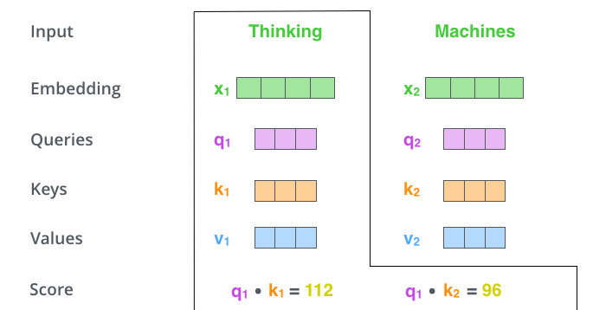
Self-Attention
Notes:
The second step in calculating self-attention is to calculate a score. Say we’re calculating the self-attention for the first word in this example, “Thinking”. We need to score each word of the input sentence against this word. The score determines how much focus to place on other parts of the input sentence as we encode a word at a certain position.
The score is calculated by taking the dot product of the query vector with the key vector of the respective word we’re scoring. So if we’re processing the self-attention for the word in position #1, the first score would be the dot product of q1 and k1. The second score would be the dot product of q1 and k2.

Slide 20
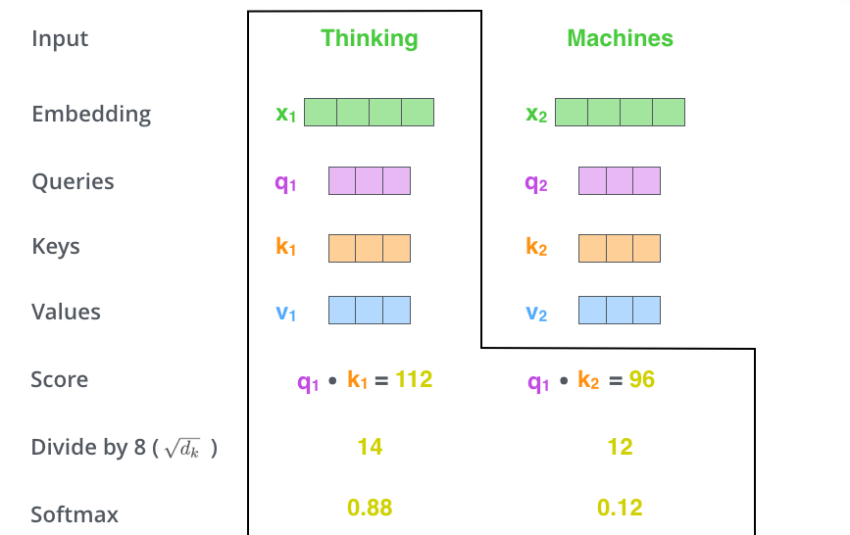
Self Attention
Notes:
This softmax score determines how much each word will be expressed at this position. Clearly the word at this position will have the highest softmax score, but sometimes it’s useful to attend to another word that is relevant to the current word.

Slide 21

Self_Attention
Notes:
The fifth step is to multiply each value vector by the softmax score (in preparation to sum them up). The intuition here is to keep intact the values of the word(s) we want to focus on, and drown-out irrelevant words (by multiplying them by tiny numbers like 0.001, for example).
The sixth step is to sum up the weighted value vectors. This produces the output of the self-attention layer at this position (for the first word).
That concludes the self-attention calculation. The resulting vector is one we can send along to the feed-forward neural network. In the actual implementation, however, this calculation is done in matrix form for faster processing. So let’s look at that now that we’ve seen the intuition of the calculation on the word level.

Slide 22
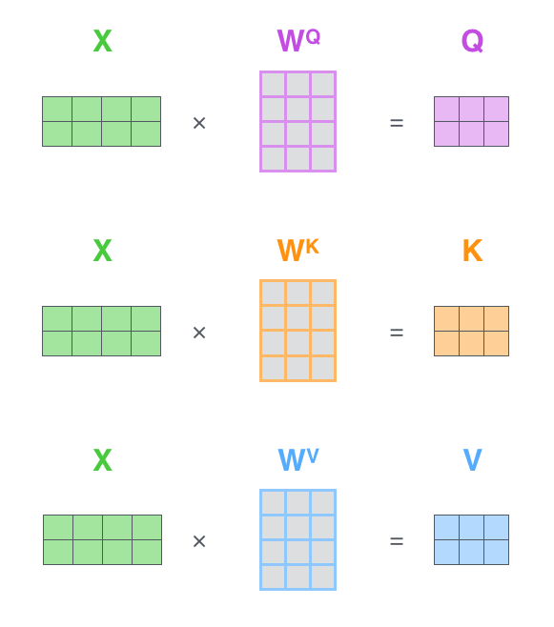

Matrix Calculation for Self Attention
Notes:
The first step is to calculate the Query, Key, and Value matrices. We do that by packing our embeddings into a matrix X, and multiplying it by the weight matrices we’ve trained (WQ, WK, WV).
Finally, since we’re dealing with matrices, we can condense steps two through six in one formula to calculate the outputs of the self-attention layer.

Slide 23
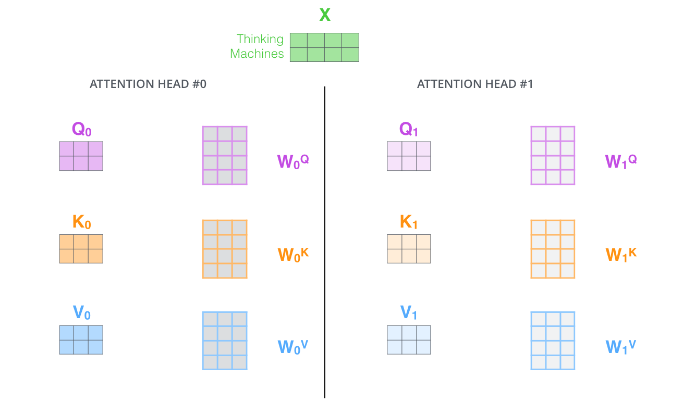
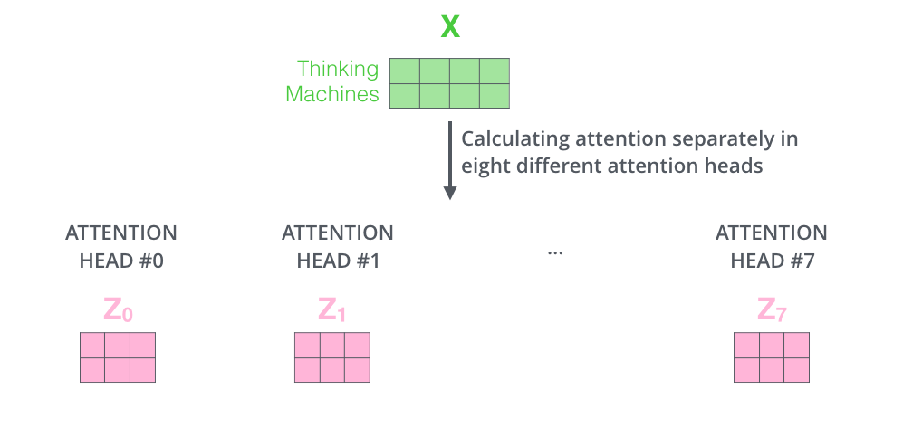
Multi-Headed Attention
Notes:
The paper further refined the self-attention layer by adding a mechanism called “multi-headed” attention. This improves the performance of the attention layer in two ways:
It expands the model’s ability to focus on different positions. Yes, in the example above, z1 contains a little bit of every other encoding, but it could be dominated by the actual word itself. If we’re translating a sentence like “The animal didn’t cross the street because it was too tired”, it would be useful to know which word “it” refers to.
It gives the attention layer multiple “representation subspaces”. As we’ll see next, with multi-headed attention we have not only one, but multiple sets of Query/Key/Value weight matrices (the Transformer uses eight attention heads, so we end up with eight sets for each encoder/decoder). Each of these sets is randomly initialized. Then, after training, each set is used to project the input embeddings (or vectors from lower encoders/decoders) into a different representation subspace.

Slide 24
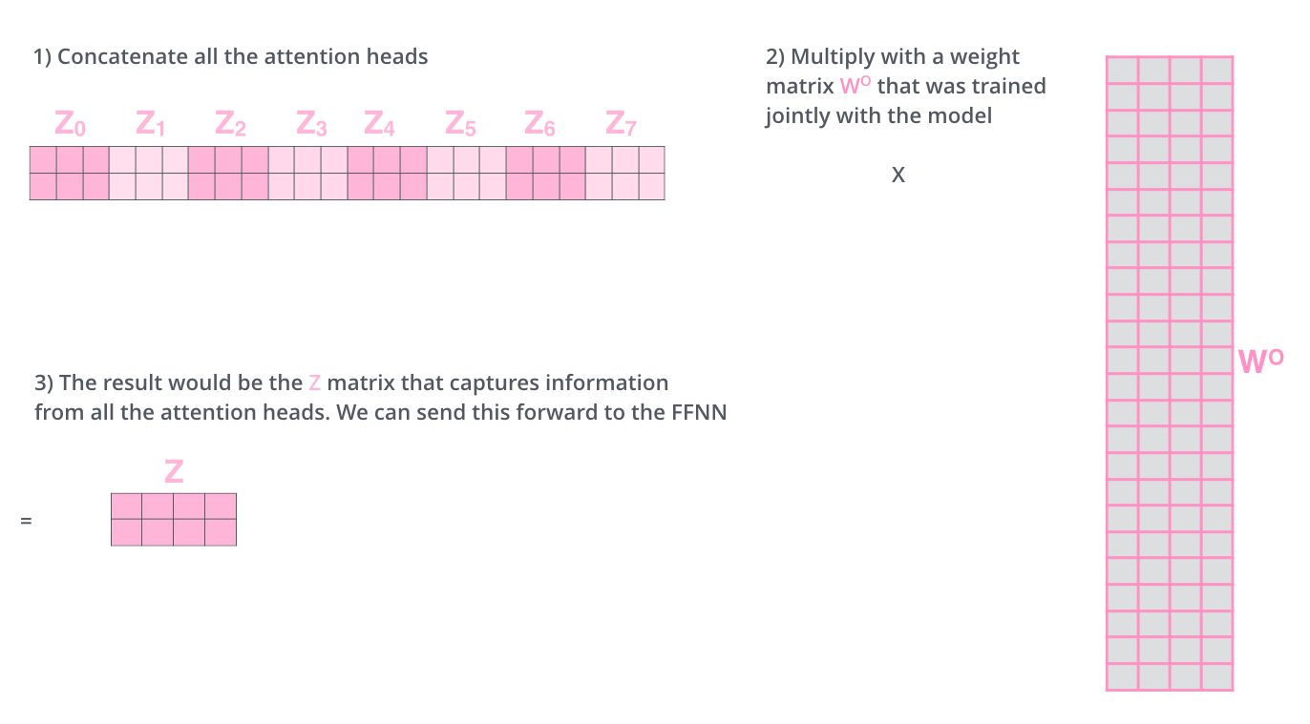
Multi-Headed Attention

Slide 25


Slide 26
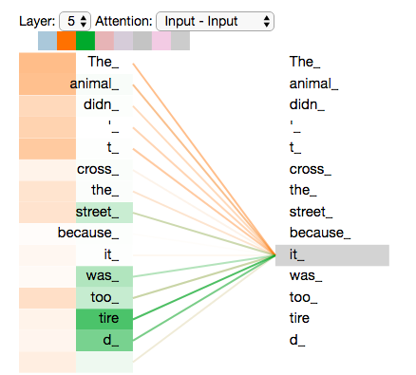
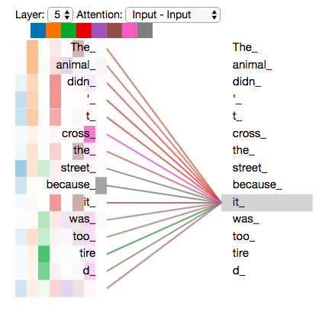
What Multi-heads doing
Notes:
Now that we have touched upon attention heads, let’s revisit our example from before to see where the different attention heads are focusing as we encode the word “it” in our example sentence:
If we add all the attention heads to the picture, however, things can be harder to interpret:

Slide 27
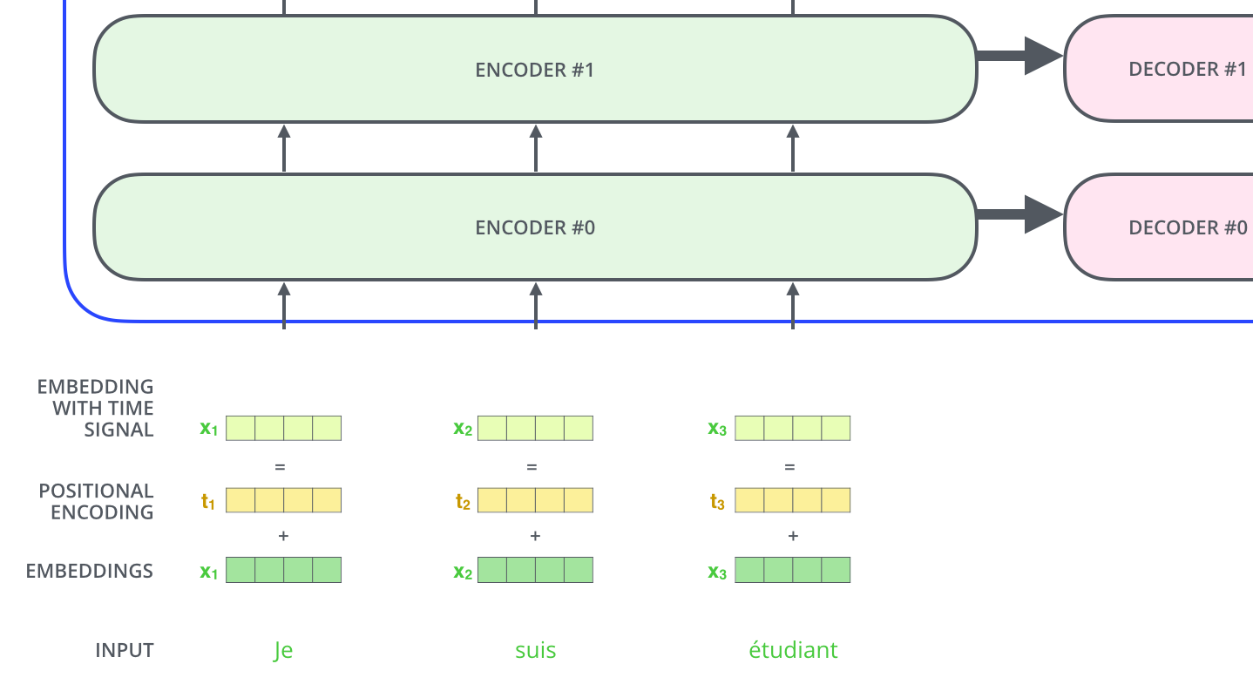
Order of The Sequence -Positional Encoding
Notes:
To address this, the transformer adds a vector to each input embedding. These vectors follow a specific pattern that the model learns, which helps it determine the position of each word, or the distance between different words in the sequence. The intuition here is that adding these values to the embeddings provides meaningful distances between the embedding vectors once they’re projected into Q/K/V vectors and during dot-product attention.

Slide 28
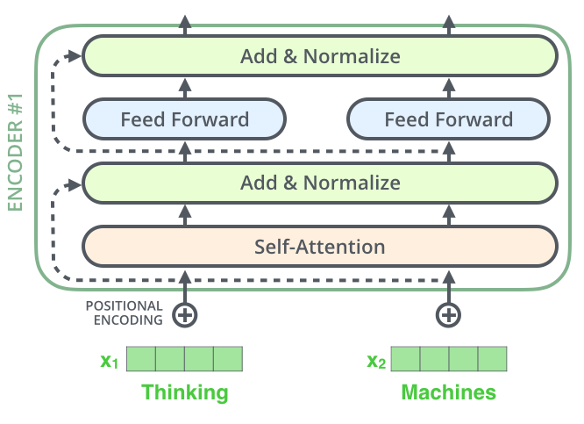
Residuals
Notes:
One detail in the architecture of the encoder that we need to mention before moving on, is that each sub-layer (self-attention, ffnn) in each encoder has a residual connection around it, and is followed by a layer-normalization step.

Slide 29

Notes:
If we’re to visualize the vectors and the layer-norm operation associated with self attention, it would look like this:

Slide 30

Encoder-Decoder
Notes:
This goes for the sub-layers of the decoder as well. If we’re to think of a Transformer of 2 stacked encoders and decoders, it would look something like this:

Slide 31

Decoder
Notes:
The encoder start by processing the input sequence. The output of the top encoder is then transformed into a set of attention vectors K and V. These are to be used by each decoder in its “encoder-decoder attention” layer which helps the decoder focus on appropriate places in the input sequence:

Slide 32

Decoder
Notes:
The following steps repeat the process until a special symbol is reached indicating the transformer decoder has completed its output. The output of each step is fed to the bottom decoder in the next time step, and the decoders bubble up their decoding results just like the encoders did. And just like we did with the encoder inputs, we embed and add positional encoding to those decoder inputs to indicate the position of each word.
The self attention layers in the decoder operate in a slightly different way than the one in the encoder:
In the decoder, the self-attention layer is only allowed to attend to earlier positions in the output sequence. This is done by masking future positions (setting them to -inf) before the softmax step in the self-attention calculation.
The “Encoder-Decoder Attention” layer works just like multiheaded self-attention, except it creates its Queries matrix from the layer below it, and takes the Keys and Values matrix from the output of the encoder stack.

Slide 33
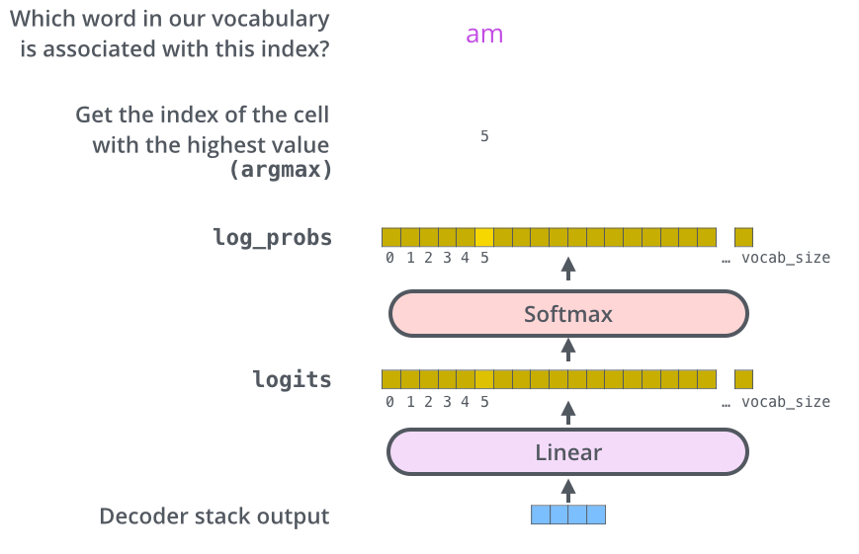
Final Layer
Notes:
The decoder stack outputs a vector of floats. How do we turn that into a word? That’s the job of the final Linear layer which is followed by a Softmax Layer.
The Linear layer is a simple fully connected neural network that projects the vector produced by the stack of decoders, into a much, much larger vector called a logits vector.
Let’s assume that our model knows 10,000 unique English words (our model’s “output vocabulary”) that it’s learned from its training dataset. This would make the logits vector 10,000 cells wide – each cell corresponding to the score of a unique word. That is how we interpret the output of the model followed by the Linear layer.
The softmax layer then turns those scores into probabilities (all positive, all add up to 1.0). The cell with the highest probability is chosen, and the word associated with it is produced as the output for this time step.

Slide 34
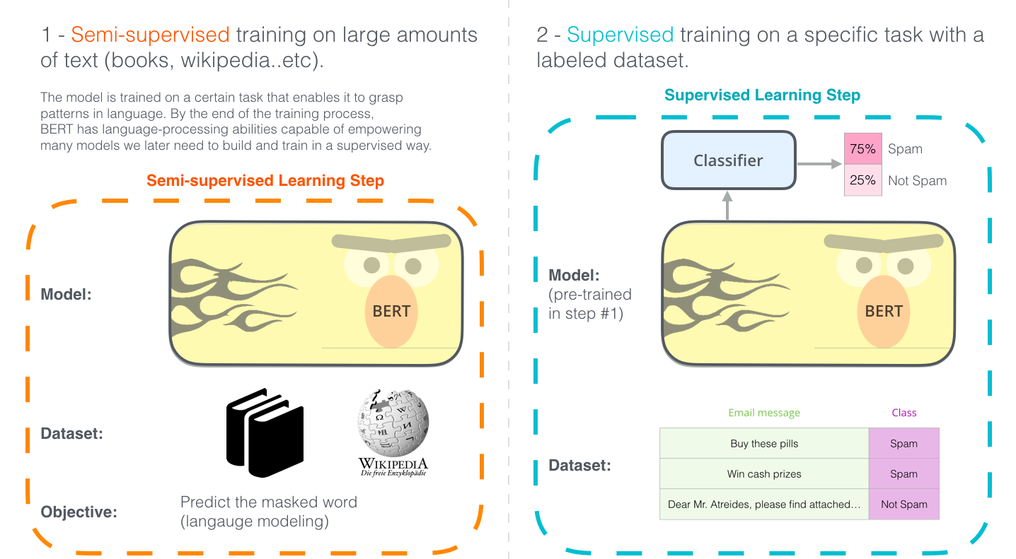
BERT

Slide 35
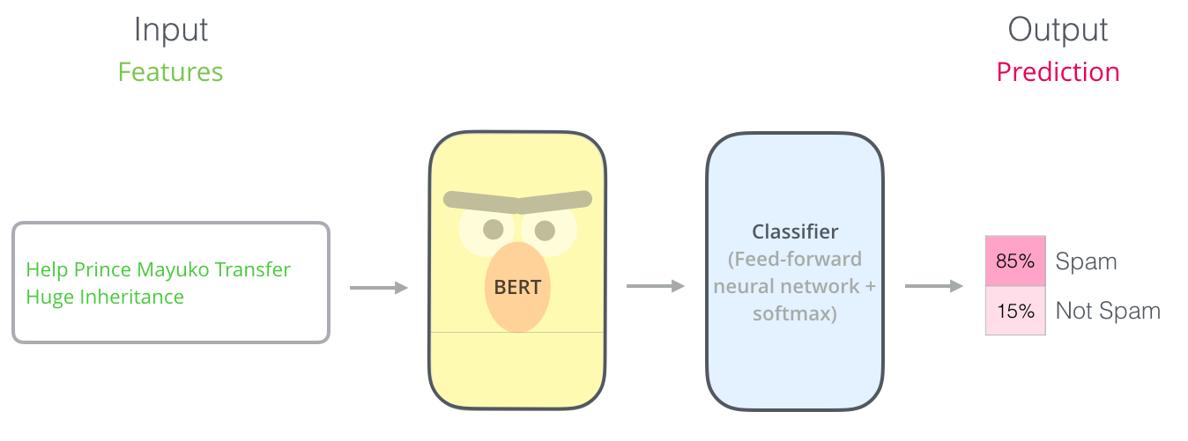
Sentence Classification
Notes:
The most straight-forward way to use BERT is to use it to classify a single piece of text. This model would look like thi
To train such a model, you mainly have to train the classifier, with minimal changes happening to the BERT model during the training phase. This training process is called Fine-Tuning,

Slide 36
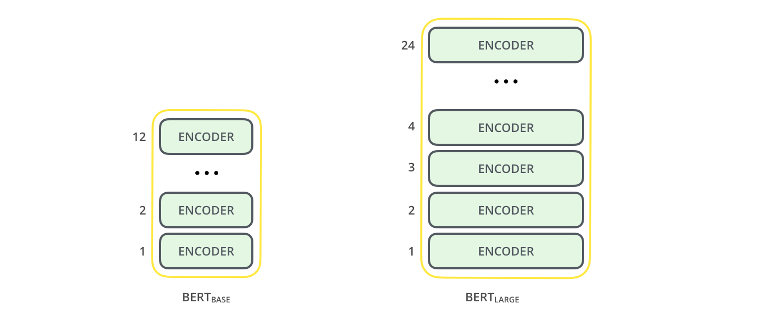
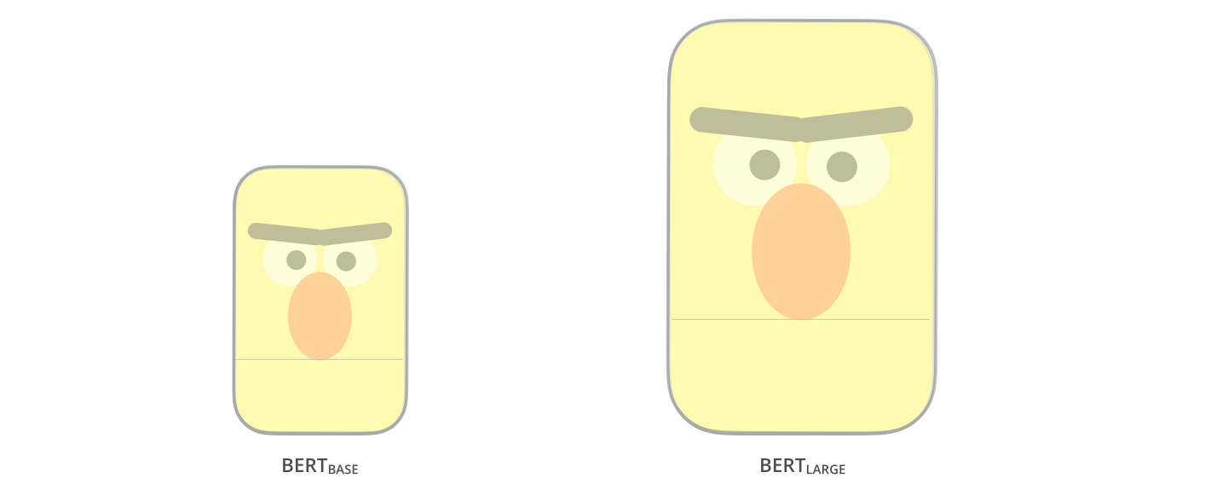
BERT
Notes:
Both BERT model sizes have a large number of encoder layers (which the paper calls Transformer Blocks) – twelve for the Base version, and twenty four for the Large version. These also have larger feedforward-networks (768 and 1024 hidden units respectively), and more attention heads (12 and 16 respectively) than the default configuration in the reference implementation of the Transformer in the initial paper (6 encoder layers, 512 hidden units, and 8 attention heads)

Slide 37
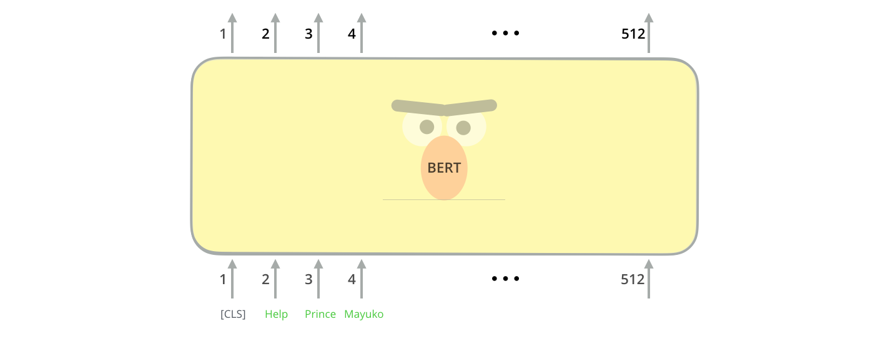
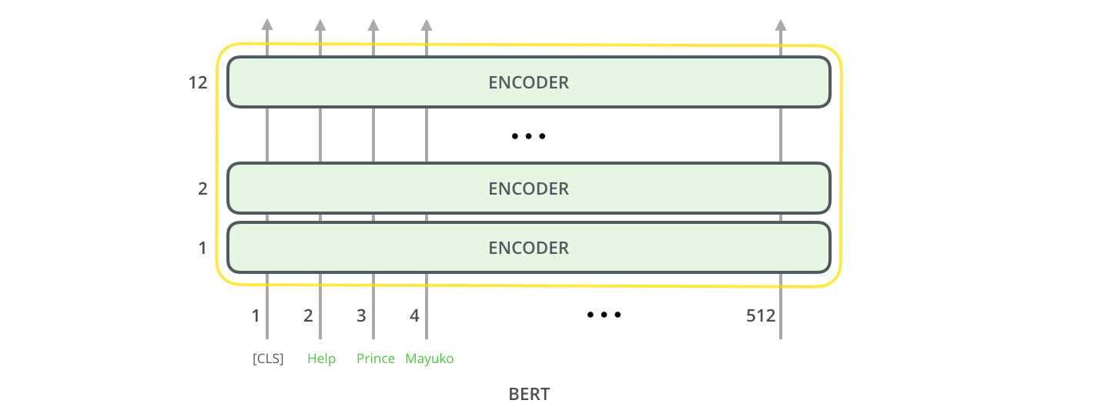
BERT-Inputs
Notes:
The first input token is supplied with a special [CLS] token for reasons that will become apparent later on. CLS here stands for Classification.
Just like the vanilla encoder of the transformer, BERT takes a sequence of words as input which keep flowing up the stack. Each layer applies self-attention, and passes its results through a feed-forward network, and then hands it off to the next encoder.
In terms of architecture, this has been identical to the Transformer up until this point (aside from size, which are just configurations we can set). It is at the output that we first start seeing how things diverge.

Slide 38
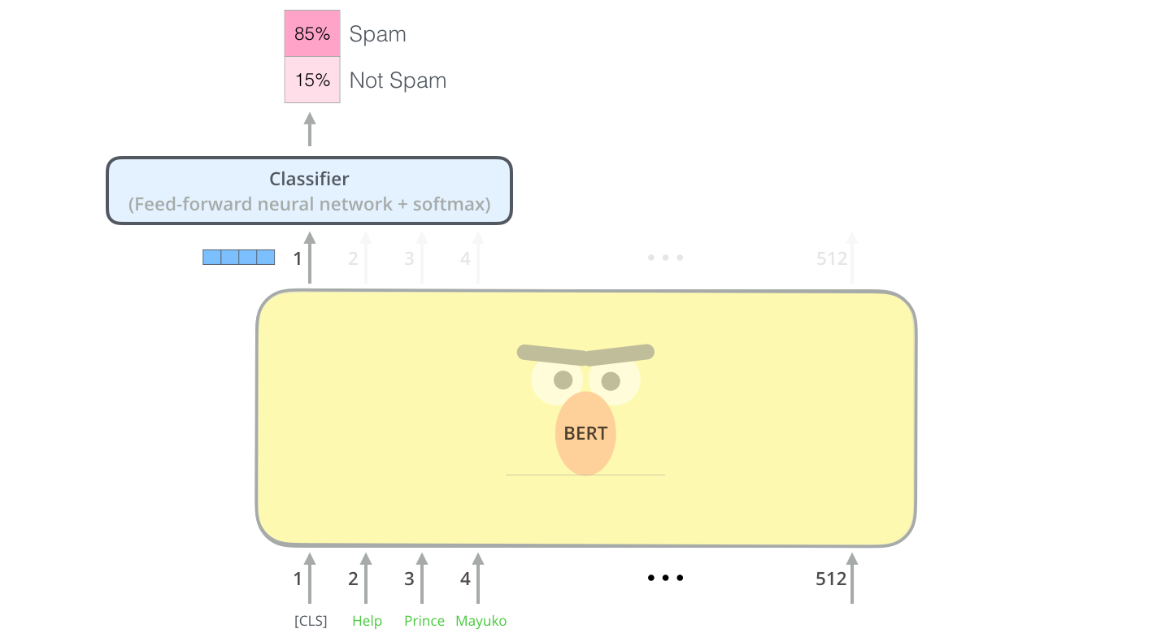
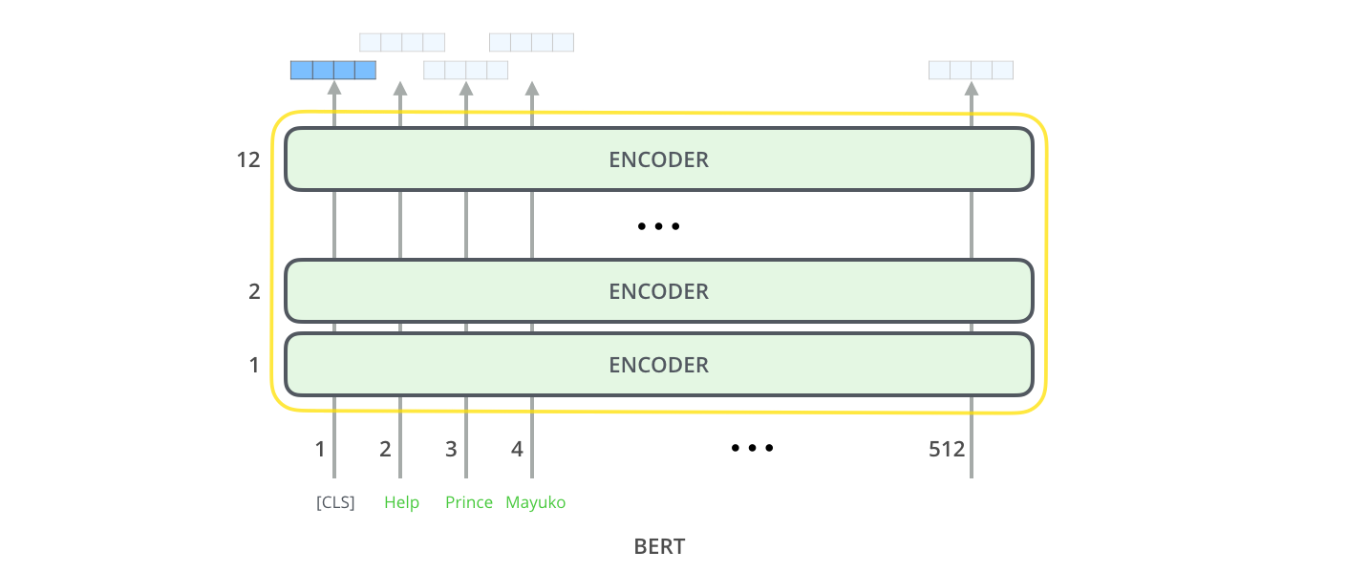
BERT_outputs
Notes:
That vector can now be used as the input for a classifier of our choosing. The paper achieves great results by just using a single-layer neural network as the classifier.
If you have more labels (for example if you’re an email service that tags emails with “spam”, “not spam”, “social”, and “promotion”), you just tweak the classifier network to have more output neurons that then pass through softmax.

Slide 40
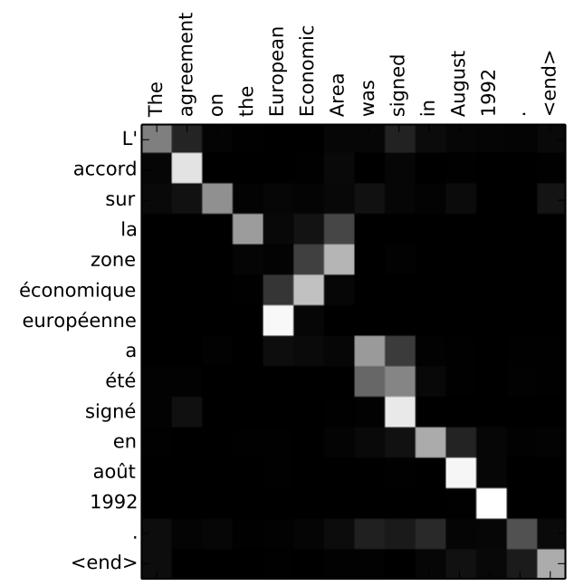

Slide 41
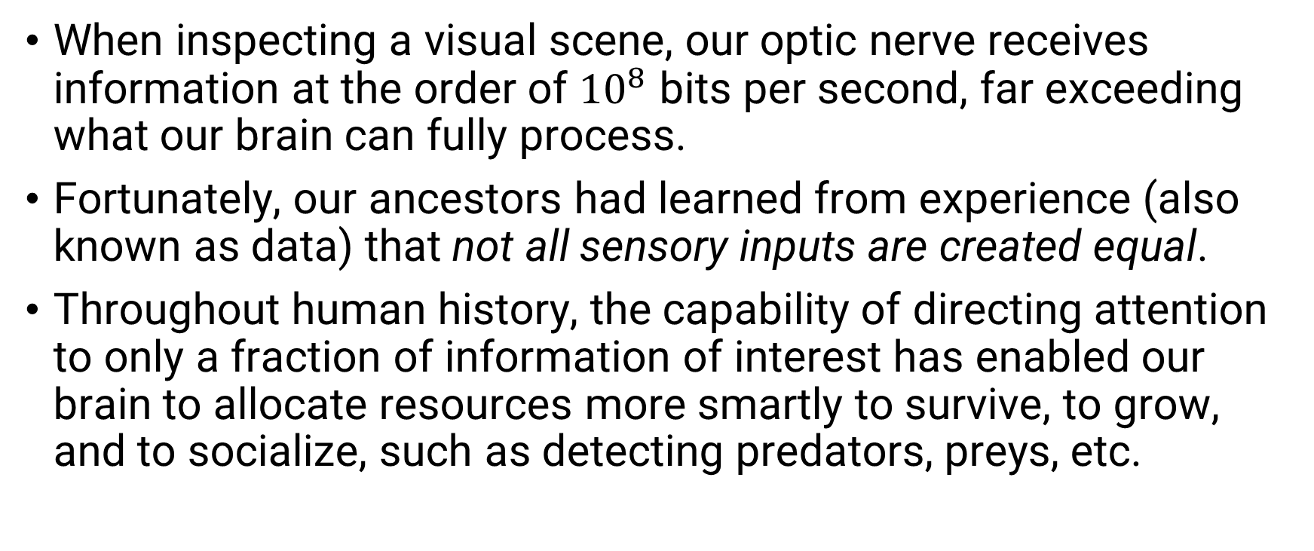
Attention
When inspecting a visual scene, our optic nerve receives information at the order of ${10}^{8}$ bits per second, far exceeding what our brain can fully process.
Fortunately, our ancestors had learned from experience (also known as data) that not all sensory inputs are created equal.
Throughout human history, the capability of directing attention to only a fraction of information of interest has enabled our brain to allocate resources more smartly to survive, to grow, and to socialize, such as detecting predators, preys, etc.

Slide 42
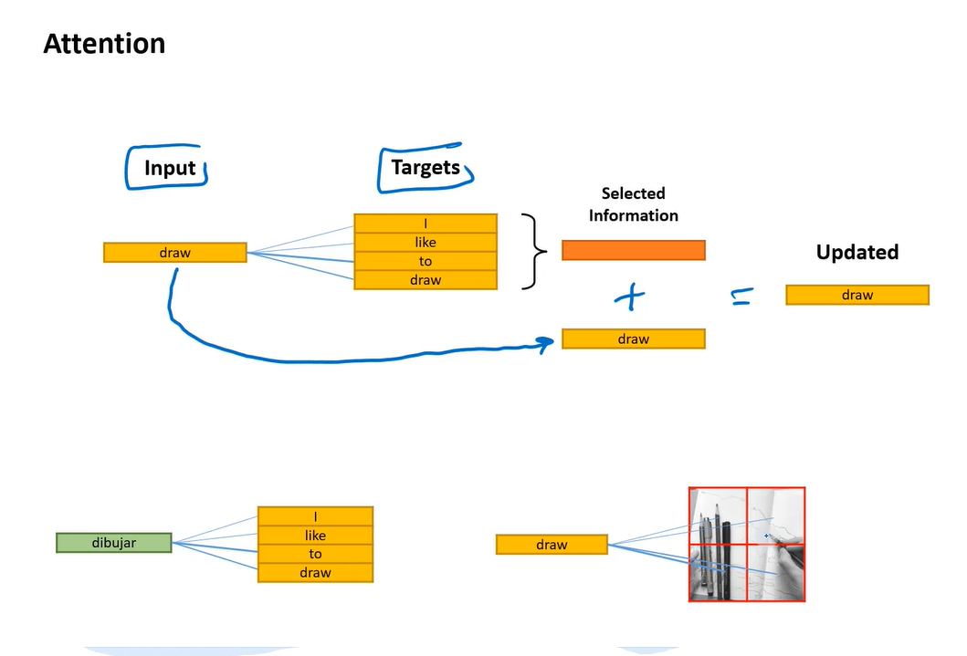
Generalized Self Attention
Notes:
2 - Generalized Self-Attention
Self-Attention is a powerful tool in neural networks, and not just for Transformer architectures.
Here is how I would describe its purpose in a more general way:
It operates between two sets of vectors: “inputs” and “targets”.
The goal is to “enhance” the input vectors with information from the targets.
The input and target vectors do not necessarily need to be the same type of data!
You can often find ways to create embedding representations of anything–for example, an image, a product, or a person’s taste in music! And any of these could be used as inputs or targets for attention.
You could enrich the embedding for an image by pulling information from the words in its caption. You could enrich the embedding for a song by pulling information from the “taste vectors” of the listeners who like it.
Lots of possibilities!

Slide 43
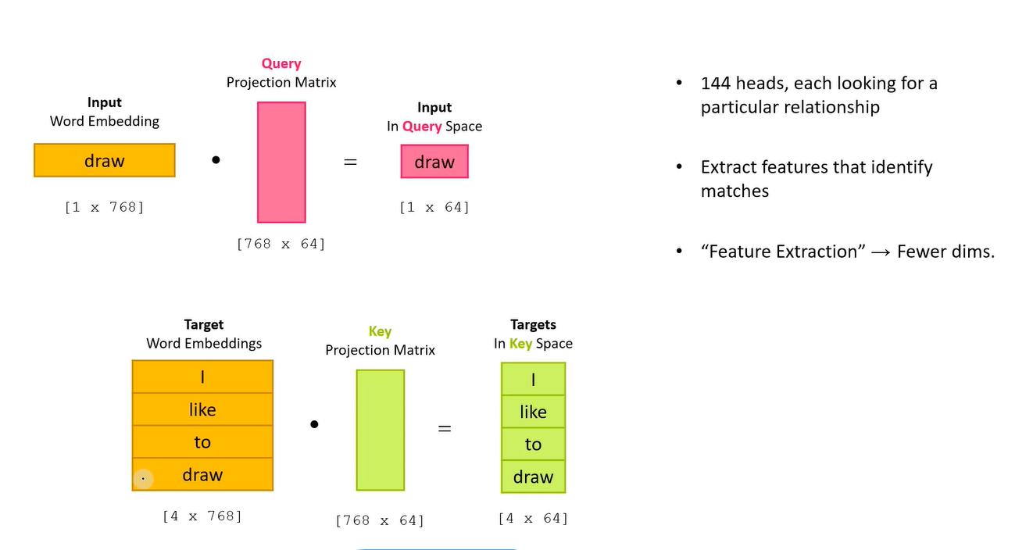
Attention Score- Step 1 - Projection
Notes:
Transformer models contain many attention heads, and each one serves a different role.
They generally seem to be looking for a particular relationship between an input and a target. For example, one head might recognize the relationship between a verb and its “direct object” (e.g. I drew a tree).
The input vectors are projected onto a “query” space, and the targets are projected onto a “key” space. Projecting them onto these spaces allows the head to identify the relationship it’s looking for; if an input and target have that relationship, then the dot product between their query and key vectors will be high!

Slide 44
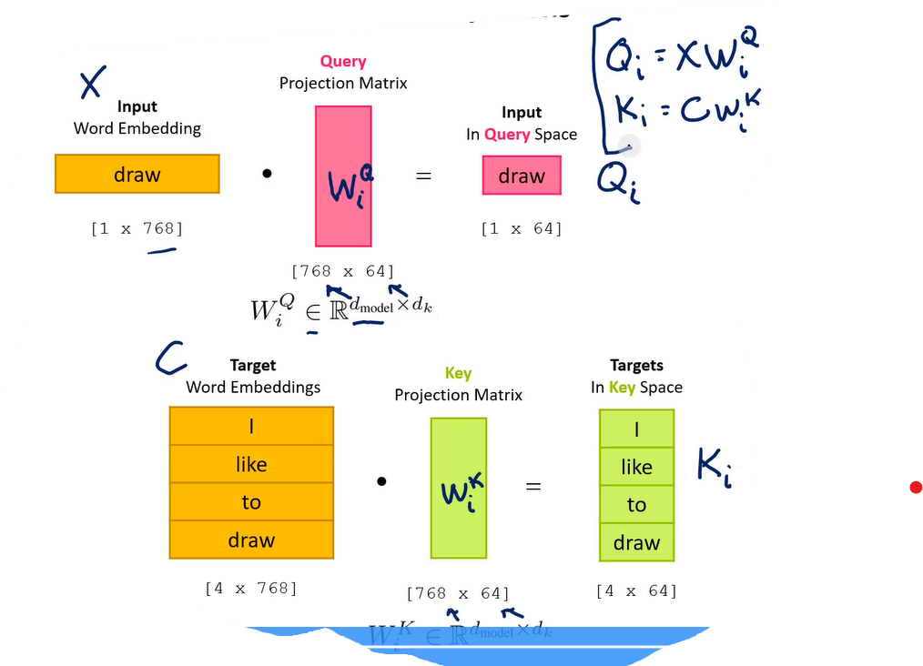
Attention Score- Step 1 - Projection
Notes:
The projection matrices are given the variable ‘W’, (and distinguished with a superscript: Q, K, or V).
‘X’ is typically used to represent the input vectors. For the target vectors, I’m choosing to use the variable ‘C’ (which could stand for “context”).
A note on vector lengths: For generalized attention, the inputs and targets could be different vector lengths, but they must be projected to the same dimension for calculating the attention scores.

Slide 45
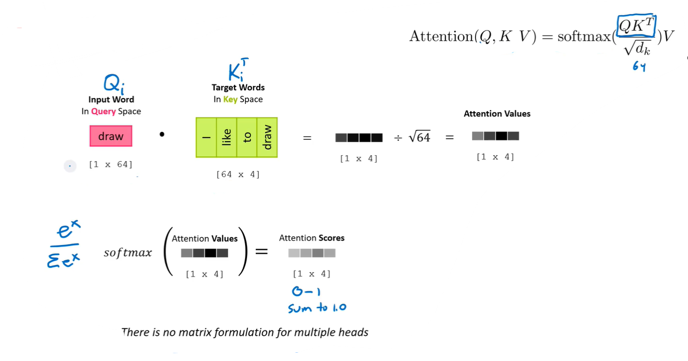
Attention Score
Notes:
For each head, we multiply the query vector with the keys. This gives us the attention “values”, one per target. Applying the softmax function to those values gives us the attention scores.
The authors also found it helpful to scale down the attention values before applying the softmax in order to avoid “vanishing gradients”.

Slide 46
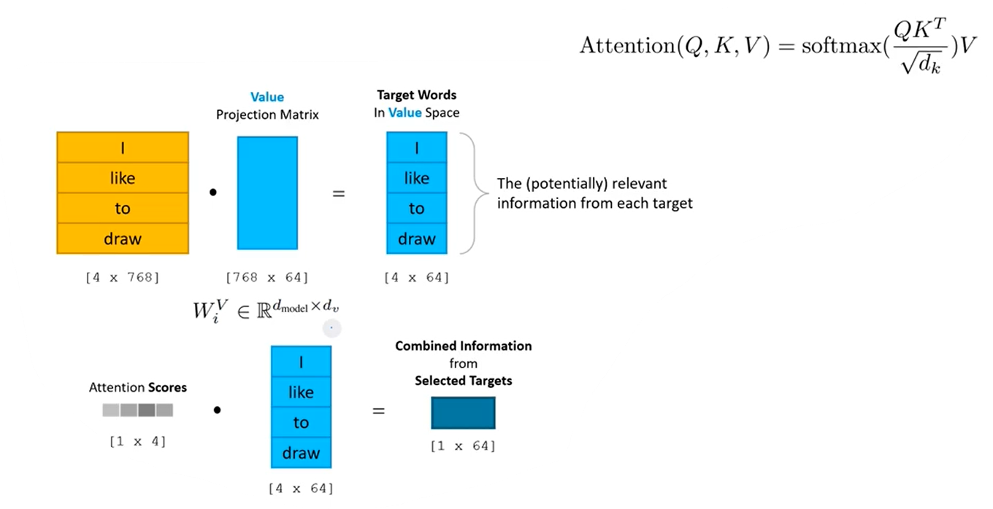
Value Vector Information selection
Notes:
When we project a target vector onto the Value space, we are extracting the information that this head is responsible for gathering from the target.
Even though not all (or possibly not any!) of the targets are relevant to this particular attention head, we project them all anyway.
(Because of how matrix multiplication works in GPUs, I suspect that it’s faster to simply do this full matrix multiplication rather than to select a subset of targets).
After projecting the targets, we can use the attention scores from the previous step to calculate a weighted average of the value vectors. This combines the information extracted from the different targets down into a single vector!

Slide 47
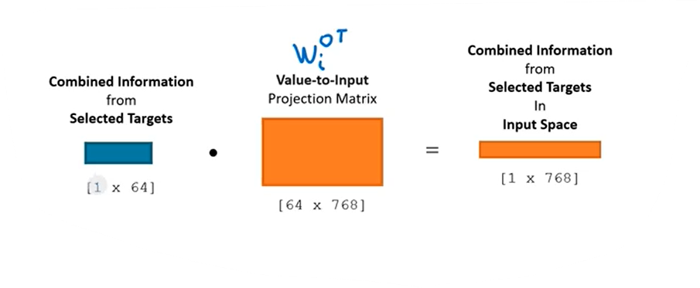
Back to input space

Slide 48
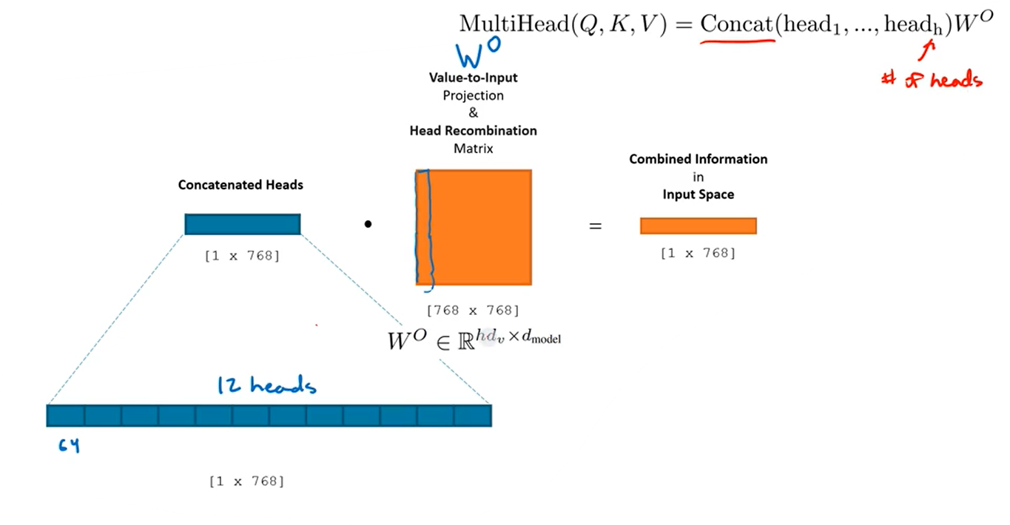
Recombining Heads
Notes:
The Value space represents our information in a different way than either the inputs or the targets. At a minimum, it has a much smaller vector length!
In order to actually add our result back to the input embedding, we need to get the selected data from the Value space projected onto the input space. This is to address the difference in vector length, but also to account for the different ways that the two spaces represent information.
Finally, we also need to combine the information gathered across the different heads! We could simply add them together, but instead we allow the model to weight the contributions of the different heads.
Projecting to input space and taking a weighted combination of the different heads is all done at once using a single matrix, W^O.

Slide 49
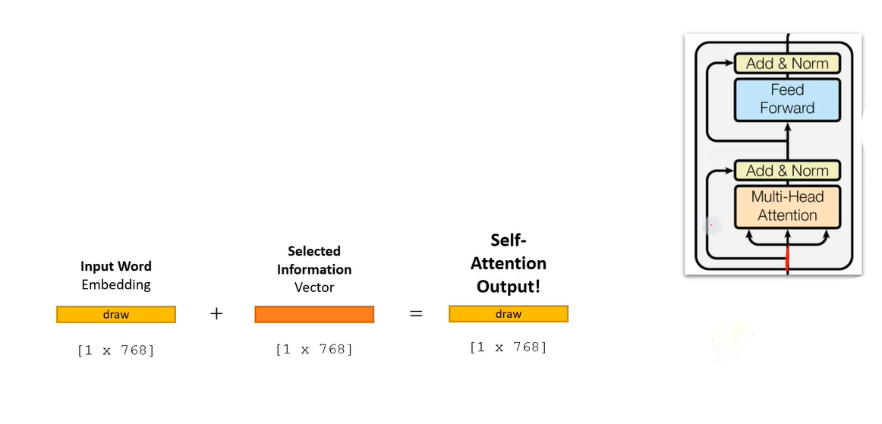
Residual
Notes:
Residuals
A standard technique used in deep neural networks is a “residual connection”. This fancy name simply refers to adding the input of a layer to its output before continuing to the next layer.
final output = layer output + input
This means that what the layer produces is not an updated vector, but rather an adjustment to make to the input vector. Apparently it is easier for a component like Self-Attention to learn how to produce an adjustment vector than an updated one, so this technique improves training.
Review
The final slide shows the full set of equations. Hopefully it’s easier now for you to quickly see the connection between the self-attention steps and their mathematical representations!

Slide 50
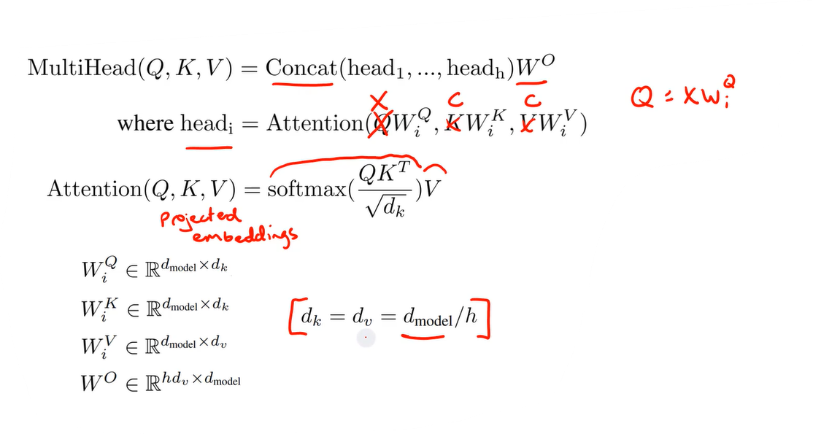
Full Equation

